Slide 1
Analysis of Indigo Interfaces
PRESENTATION BY : M.Sc.I.T. Group 1

Slide 2
Team members
Lakhan Samani: 201412051
Ravi Desai: 201412003
Ajay Hirapara: 201412084
Viraj Shah: 201412007
Fenil Shah: 201412070
Nikunj Suhagiya: 201412073
Dhaval Barot: 201412032
Deep Amin: 201412047
Harsh Soni: 201412027
Aditya Thakkar: 201412013
Chirag Sanghvi: 201412016
Karan Soni: 201412059
Kishor Davara: 201412029
Jaydeep Sarvaiya: 2014120
Bhavin Shah: 201412080
Chintan Tundia: 201412028
Rahul Salot: 201412014
Shubham Agrawal: 201412037
Sarjak Gandhi: 201412049
Jenit Shah: 201412079

Slide 3
Agenda
Task and its assumptions
Task tree
Experiment and analysis
Difference in interfaces
Comparing interface with HCI laws

Slide 4
Task and Assumptions
Experiment carried out on : 27th Sept 2015
Book a flight from Ahmedabad to Mumbai/Bombay using Indigo website and mobile app
Flight Date: 28th Sept 2015
Sample size: 14
Age group: 21-22 year
Ticket for 1 Adult passenger
Payment process is not completed by any of the user
Internet connectivity was same for all the user so that delay time is not taken into consideration
No additional services are to be selected
One way journey
Fill only credit/debit card form (no need to proceed after this process)
Sample people are guest users.

Slide 5
Subtask to be carried out
Search Flight
- Select source
- Select destination
-Select journey date
- Select journey type
- Select passenger number
Select flight
login/signup - optional
Fill user details
Select services and seat
make payment (fill payment form)

Slide 6
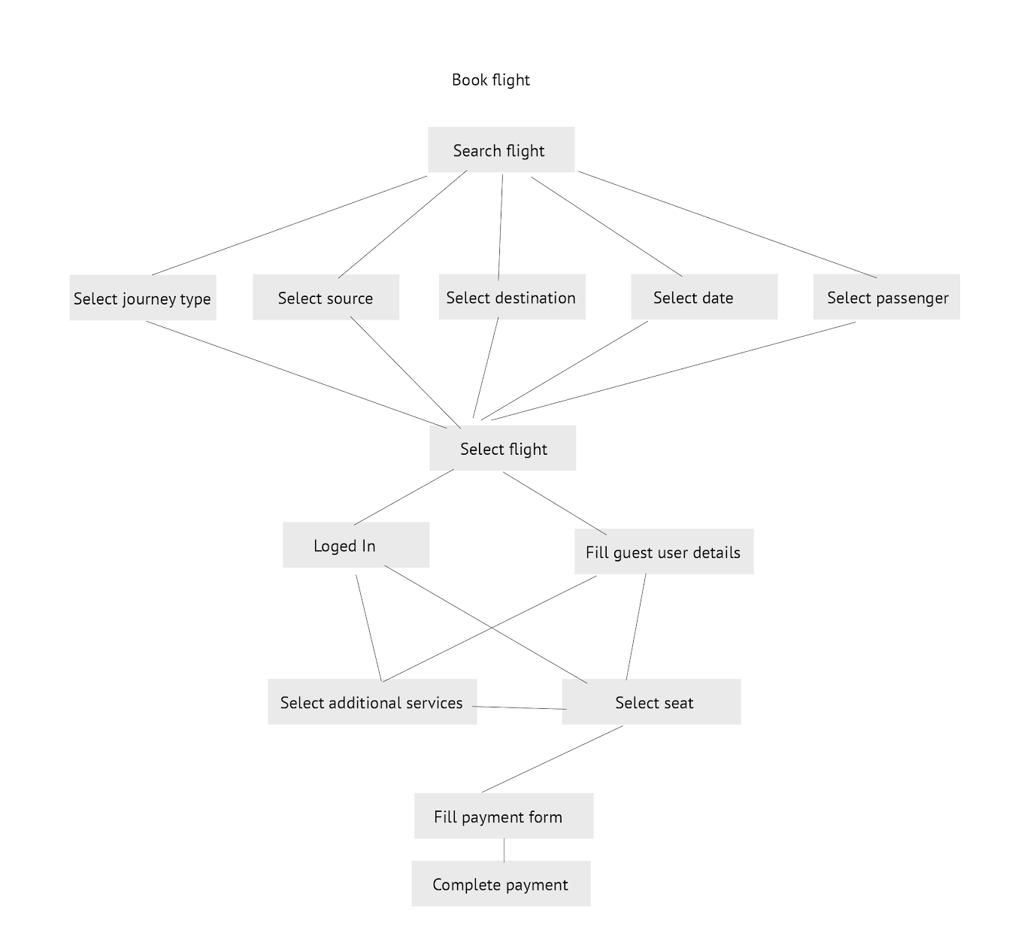
Task tree

Slide 7
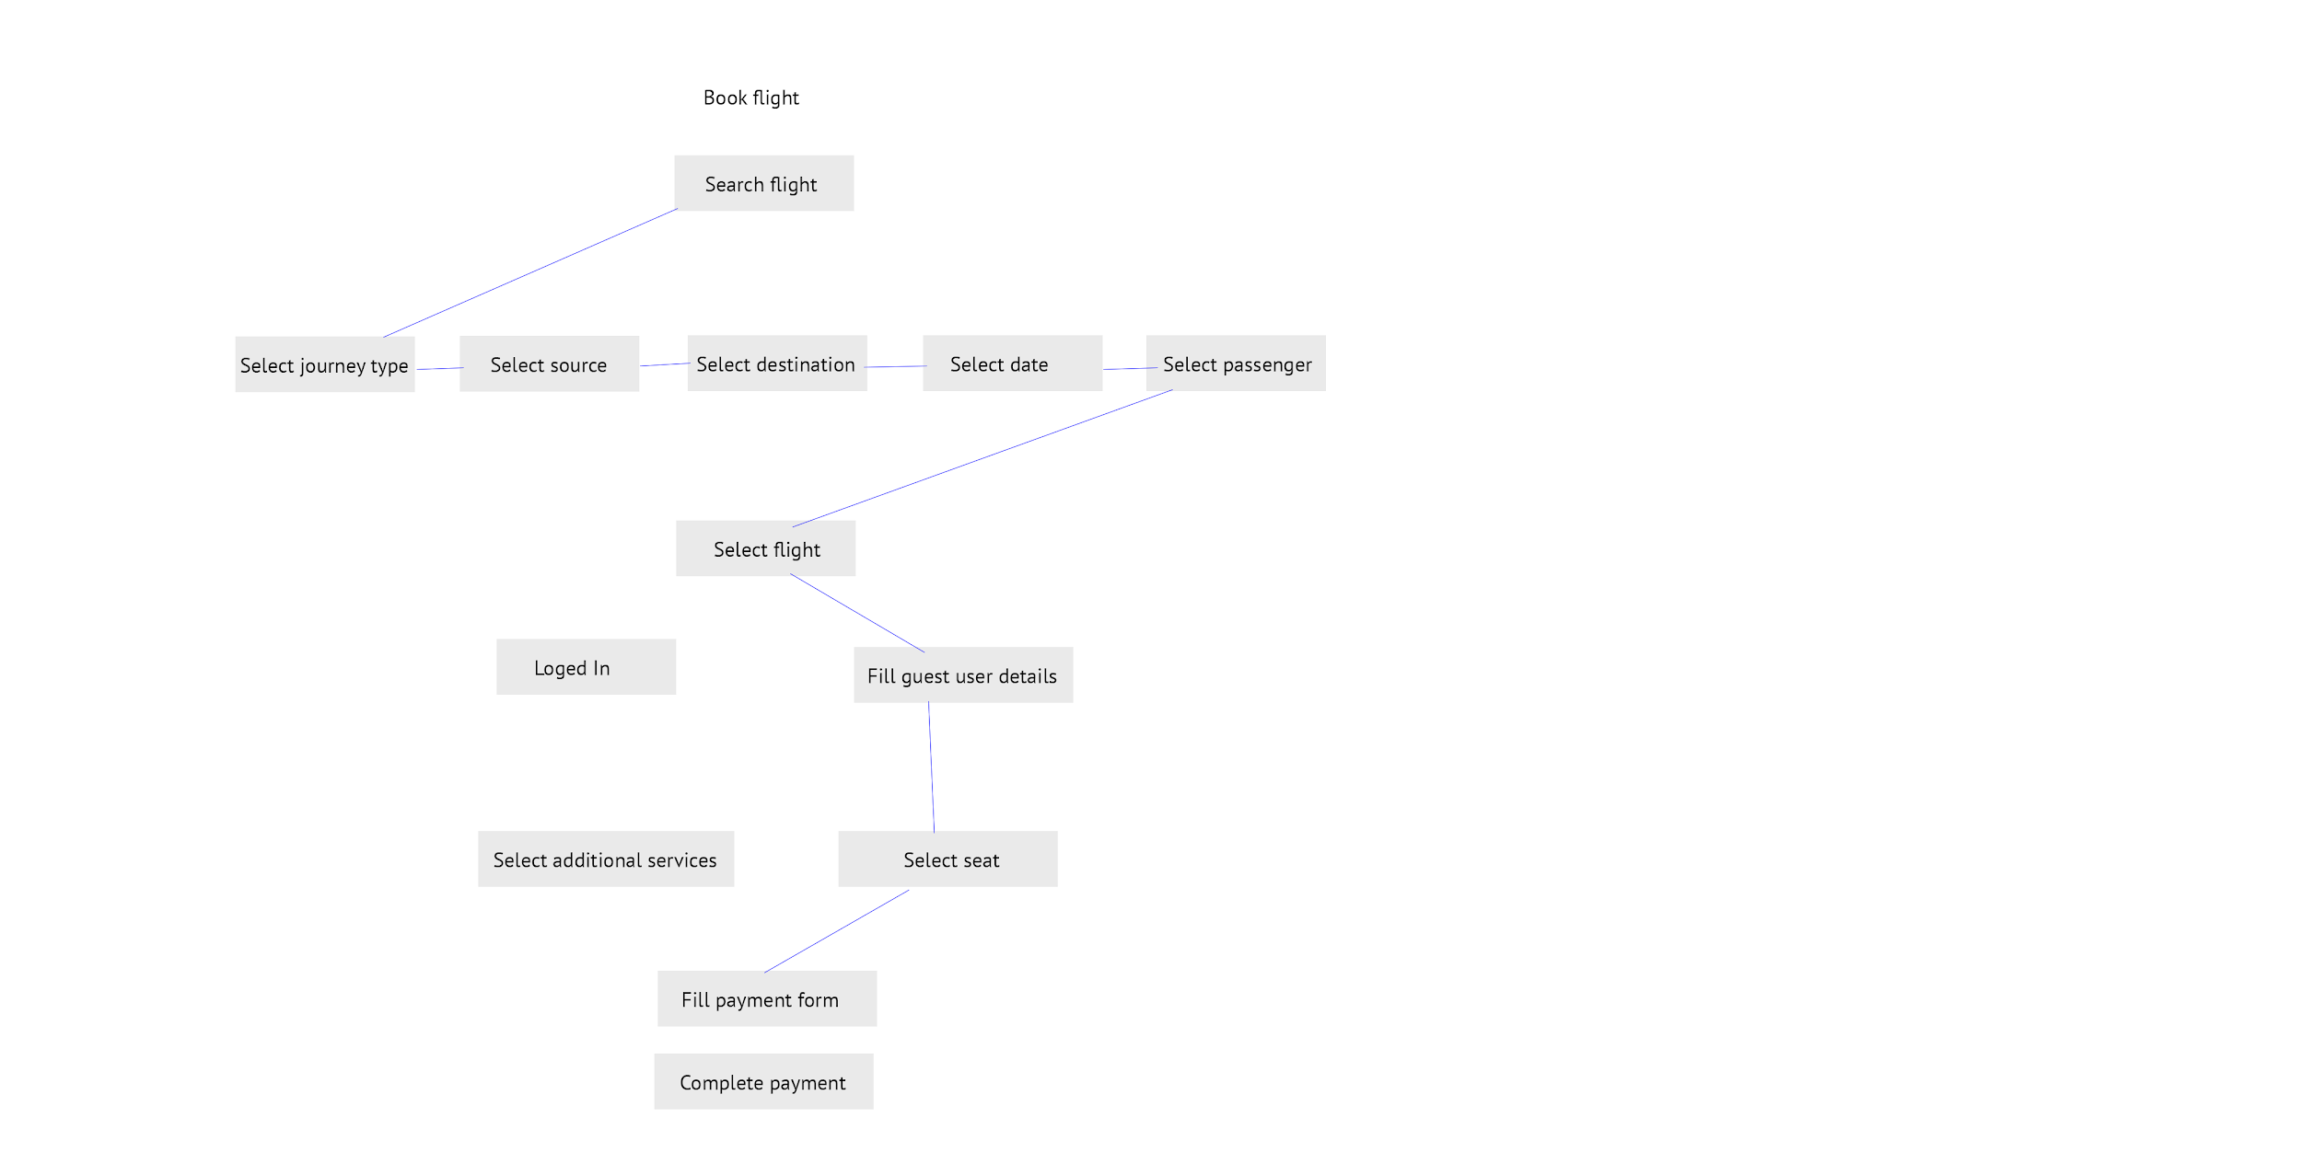
Path followed
in this experiment

Slide 8
Screens
Web Application Screen
Mobile Application Screen

Slide 9
User Experiments
Sub Task | Average Time Taken (Seconds)
 | Web Application | Mobile Application
Search flight | 24.95 | 25.82
Select flight | 24.76 | 18.20
Select seat | 32.24 | -
Select Services | 84.21 | 45.07
Payment | 56.30 | 38.27
Search Result Screen | 22.5 | 18.2
Price Summary | 15.45 | 10.79
Travel Detail | 60.2 | 57.2
Review Booking | 11 | 10.66
Total Time (Seconds) | 331.01 | 224.21
Standard Deviation of Sub task | 3.04 | 1.46

Slide 10
Comparison / Differences
Web Application | Mobile Application
Allow user to login and register | Doesn’t allow user to login and register
Seat selection is available | Seat selection is not available
Allow to book multi city flight | Doesn’t allow to book multi city flight
Shows the flight details i.e. Halt details | Doesn’t show flight details with more information

Slide 11
Analysis & its comparison with HCI Laws
Confusing because of color combinations(according to research paper in HCI-legibility and contrast)
Passenger detail form was too long and small in size (Increased motor movement, because of scroll : Fitts law)
Both having unnecessary information(advertisement because of which motor movement increases: Fitts law + Pareto’s Principle)
Too many options for additional services (Hicks law)
Too many screen transition in mobile app (motor movement increased : Fitts law)
Logo in mobile was similar to position of option (Gestalts Law : Principle of Similarity)

Slide 12
References
http://iitg.vlab.co.in/?sub=72&brch=170&sim=750&cnt=1
www.researchgate.net
https://book.goindigo.in/

